Slide 1
Studiebarometeret: Give us your opinion on your study programme!
The national student survey on the quality of study programmes

Slide 3
The Student Survey (Studiebarometeret)
The only national survey examining students’ perception of the quality of their study programme
The survey is sent annually to 2. and 5. year students from approx. 1800 study programmes
The results are published on studiebarometeret.no, where you can compare results from programmes all over Norway

Slide 4
NOKUT
The Norwegian Agency for Quality Assurance in Education (NOKUT) conducts the survey on behalf of the Norwegian Ministry of Education and Research
NOKUT works to ensure that students receive the high quality in education they are entitled to

Slide 5
We want to know what students think about:
Teaching and academic supervision
Motivation
Workload
The study environment
Working life relevance

Slide 6
How do you answer the survey?
A personal link to the survey is sent to 2. and 5. year students via email from 22 October
Students who do not respond to the email receive an invitation per SMS, and possibly a new email with a link to the survey
All information is treated confidentially, and data which may be used to identify respondents is never made public

Slide 7
Why Studiebarometeret?
Gives students the opportunity to influence their own study programme
Students are an important voice in the ongoing work to improve the quality of higher education
Gives information to universities and university colleges, helping them to improve
Gives society at large knowledge of the state of higher education

Slide 8
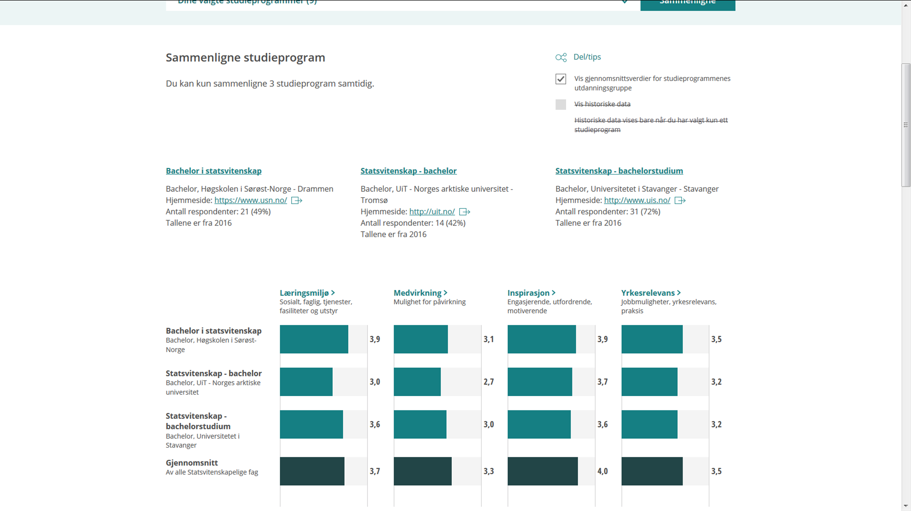

Slide 9
A high response rate is important!
Ensuring that your study programme is shown with data in the web portal
Giving universities and university colleges correct information about the quality of higher education
Your voice is important – use it!

Slide 10
Tips for increasing the response rate
Inform the students about the survey during lectures!
Close cooperation between student representatives and staff on spreading information increases the response rate
Spread information via internal information channels and notice boards
All who respond to the survey may win one of 5 or 15 gift certificates valued at NOK 5000 and 1000, respectively
Create a competitive environment at the institution!

Slide 12
More information
Read more about the survey at: http://studiebarometeret.no
Any other questions? Feel free to contact NOKUT at: studiebarometeret@nokut.no

